Slide 1
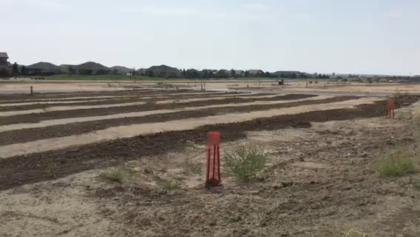
SURFACE ROUGHENING EXAMPLE

