Slide 1
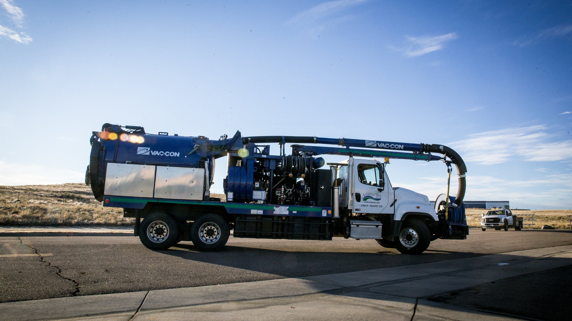
SEMSWA Vactor waste
Facility overview
James Linden and Britni Kahler
SEMSWA
January 2024

Slide 2
SEMSWA Vactor Waste Facility
Agenda
  SEMSWA’s vac truck operations & service area
  Facility Location
  Vactor Waste Facility
    History
    Design
    Drainage
    Routine Operations & Maintenance
  Runoff Control Plan
  Q & A
Notes:
Again- what should this look like in practice? I’m going to outline some of the specific permit requirements for this program and how it relates to us on a day-to-day.

Slide 3
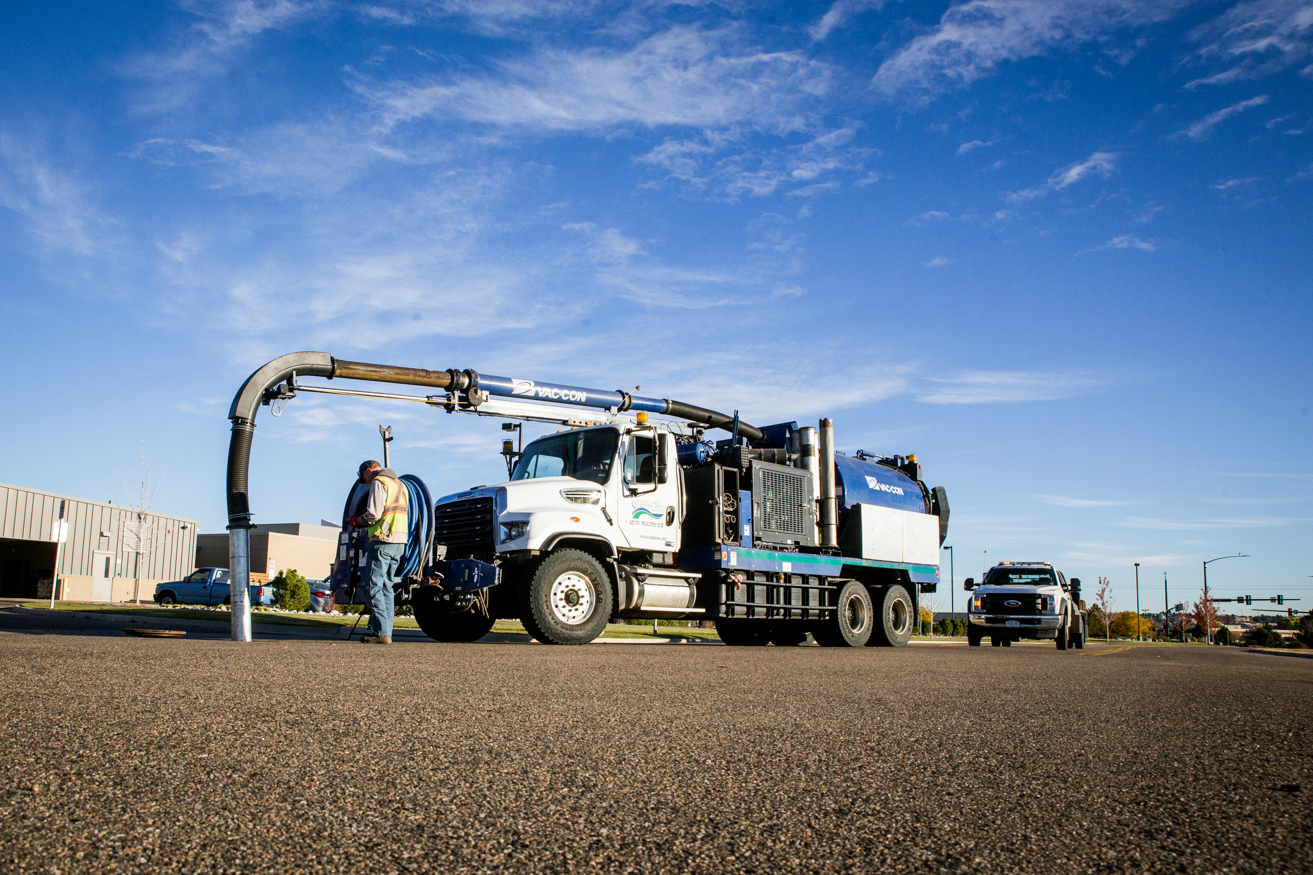
SEMSWA Vac Truck Operations
SEMSWA’s Vactor Truck is used as part of the Municipal Operations program at SEMSWA for routine maintenance projects.
The vac truck is used for cleaning sediment and debris from drains, inlets, pipes, and other storm infrastructure, and occasionally, hydro-excavating operations for locates

Slide 4
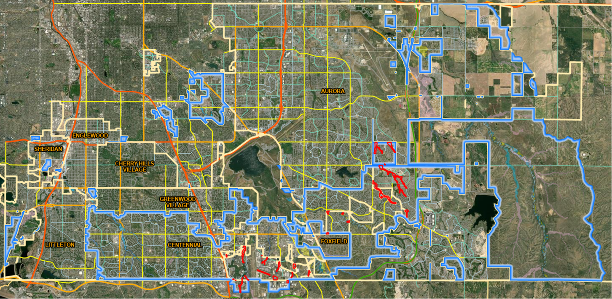
SEMSWA’s service area
Covers the City of Centennial and a portion of unincorporated Arapahoe County
Includes ECCV, IW&SD, ACWWA in Arapahoe County and Douglas County ​

Slide 5
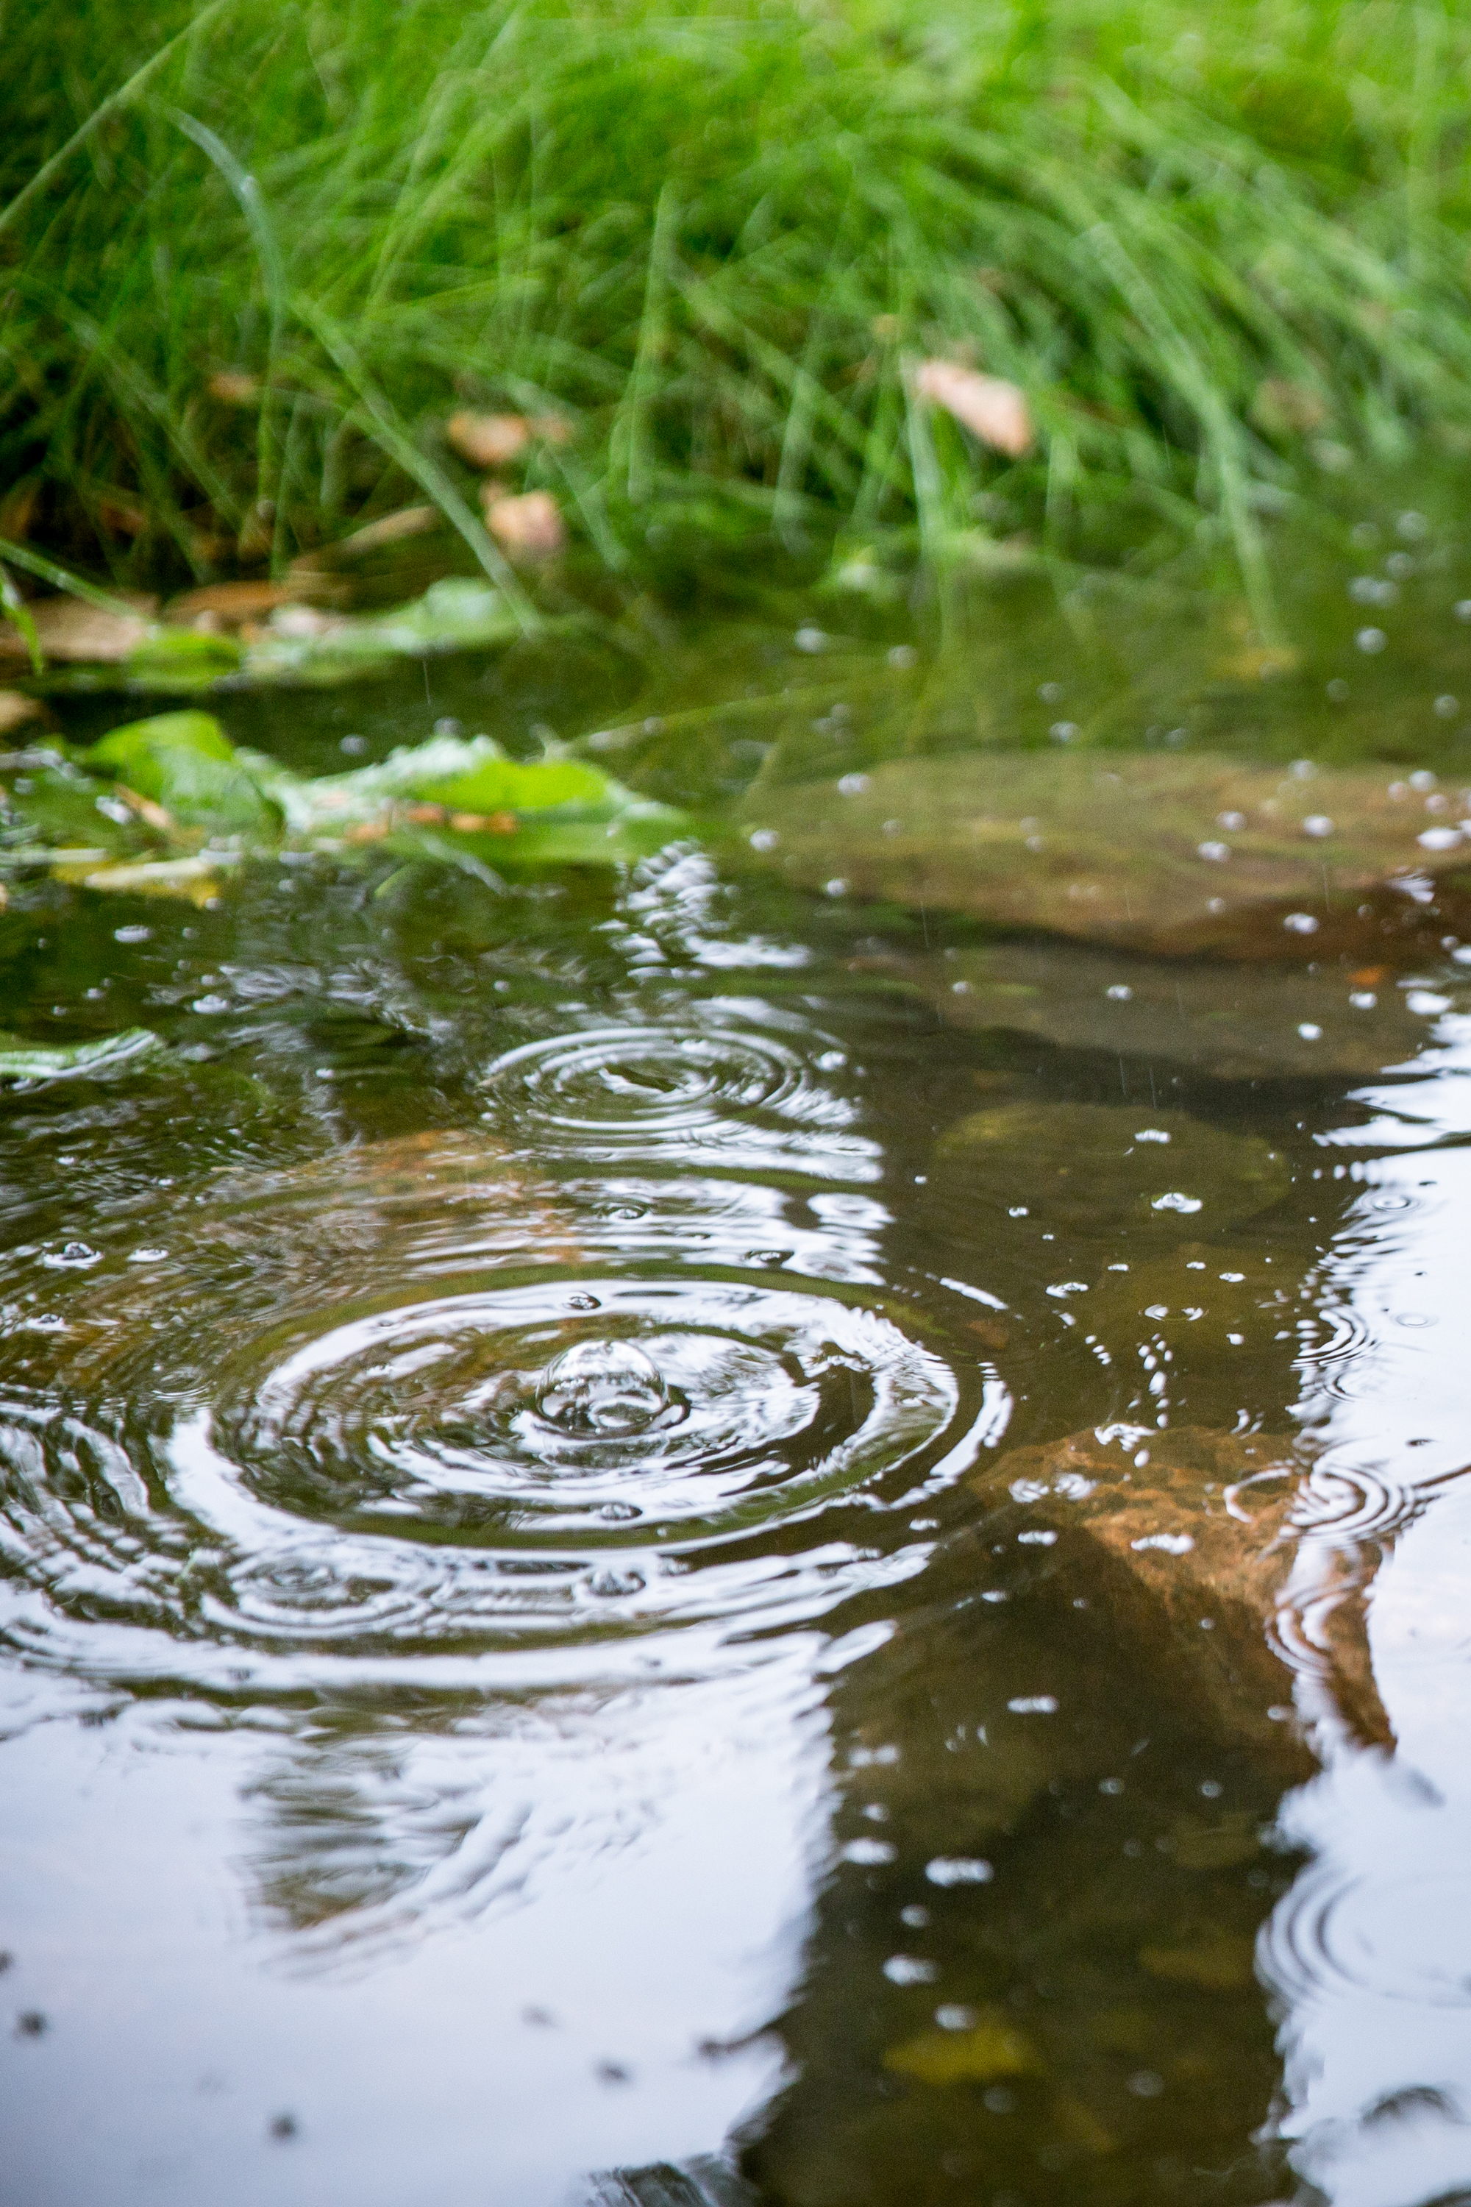
SEMSWA MS4 Permits
Centennial Standard ms4 permit
SEMSWA HOLDS THE MS4 PERMIT FOR THE CITY OF CENTENNIAL
ARAPAHOE COUNTY MS4 PERMIT
SEMSWA assists Arapahoe County with the implementation of their MS4 permit programs through a Memorandum of Understanding (MOU) between the two parties
NON-STANDARD MS4 PERMIT
SEMSWA Holds one non-standard ms4 permit for Acwwa, eccv, and Inverness water & Sanitation district

Slide 6
Municipal Separate Storm Sewer System (MS4)
1. Public Education and Outreach
3. Construction site management
4. Post-construction site management
5. Good Housekeeping and Municipal Operations
2. Illicit Discharge Detection and Elimination
Notes:
Commercial/industrial areas; old areas; Repeated complaints; WQ sampling data indicators;

Slide 7
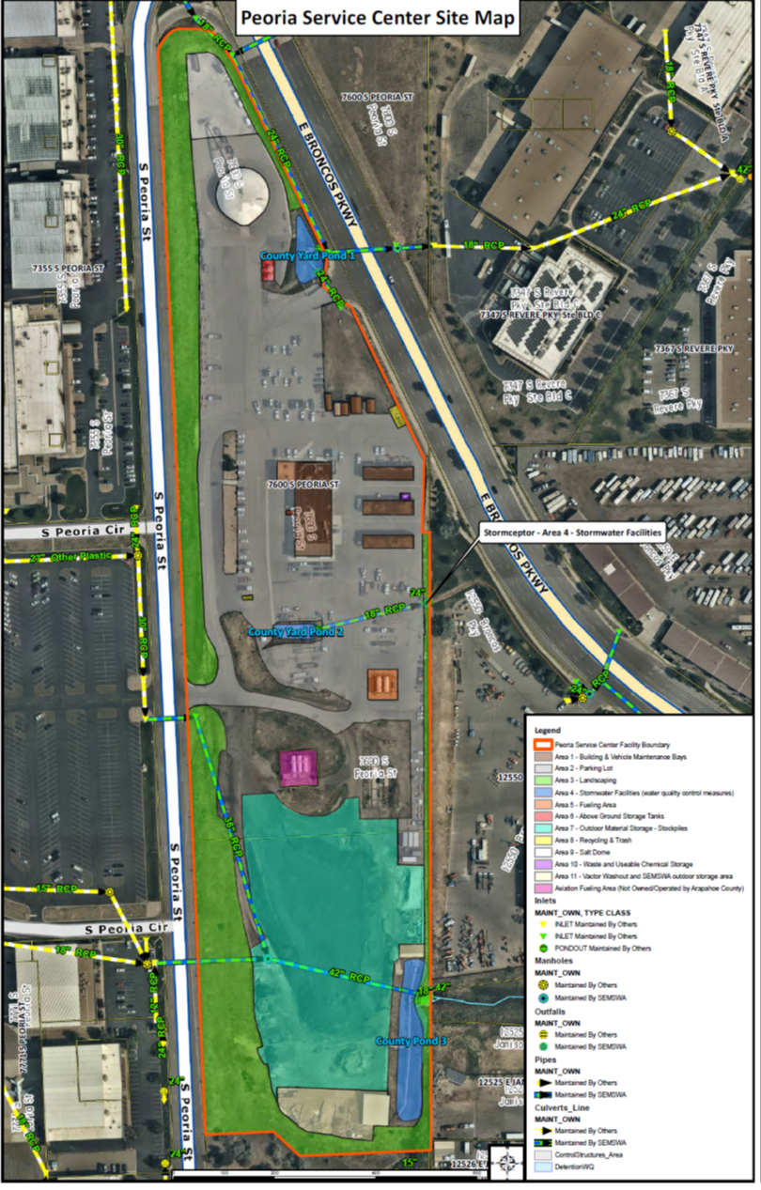
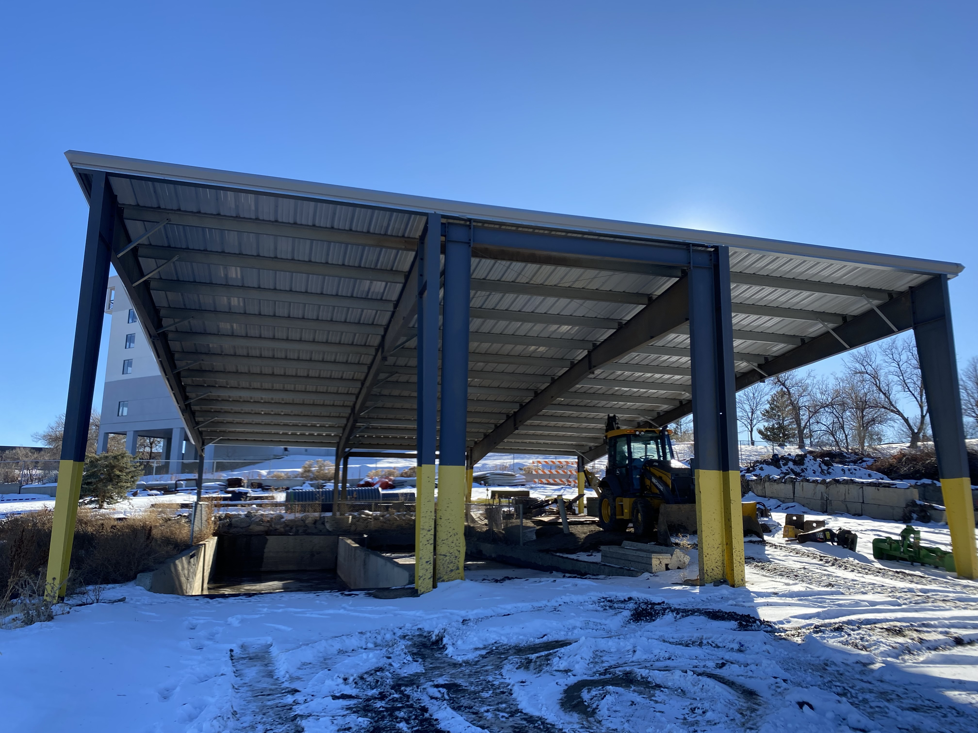
Facility Location: Arapahoe County’s Peoria Service Center
The Peoria Service Center, also known as Arapahoe County’s “Road and Bridge Facility” is located off of Broncos Parkway near SEMSWA’s main office and houses SEMSWA’s Vactor Waste Facility.
SEMSWA Vactor Waste Facility

Slide 8
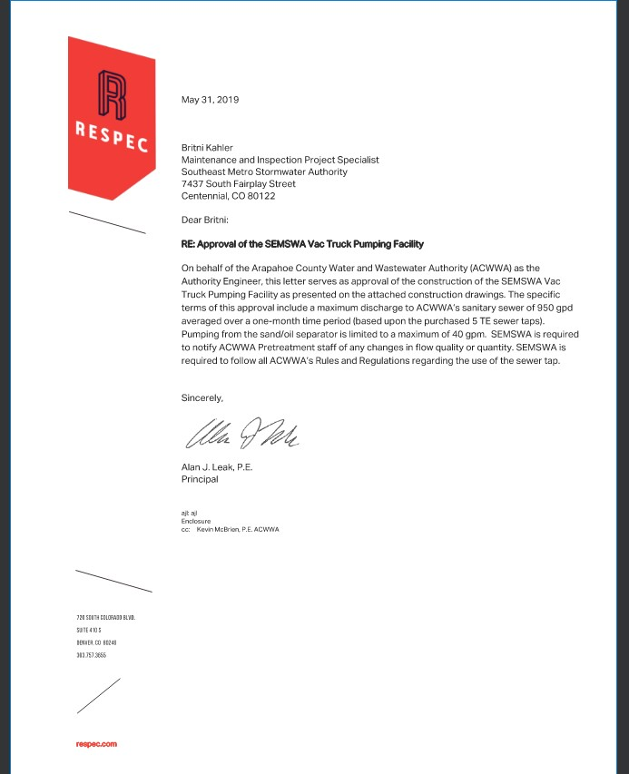
SEMSWA Vac Truck Waste Facility
ACWWA- provided approval in 2019 of the Vac Truck Pumping Facility.
The specific terms of approval include a maximum discharge to ACWWA’s sanitary sewer of 950 gallons per day (gpd) averaged over a one-month time period (based upon the purchased 5 tap equivalents (TE) sewer taps)
Pumping from the sand/oil separator is limited to a maximum of 40 gallons per minute.
SEMSWA is required to notify ACWWA Pretreatment staff of any changes in flow quality or quantity.

Slide 9
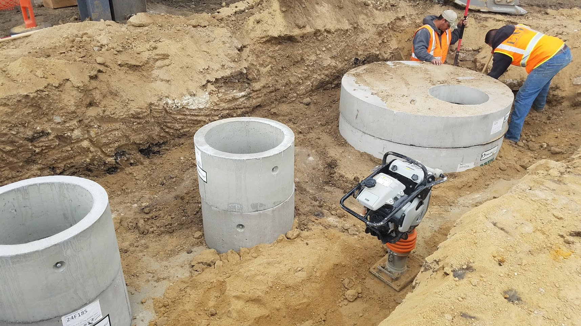
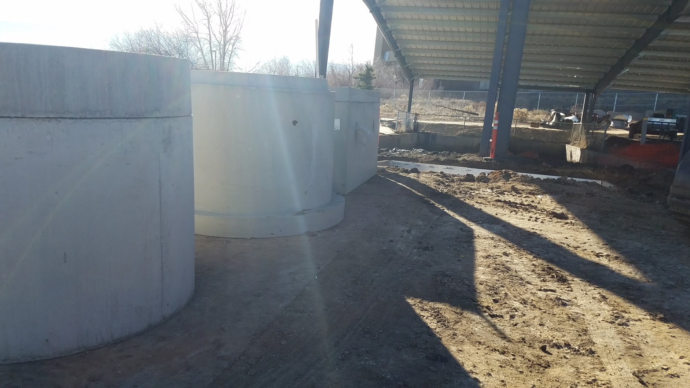
Facility Construction
Constructed in January of 2018
Took about 3 weeks to build
Facility is located at lower elevation than sanitary sewer, so we must pump out the water

Slide 10
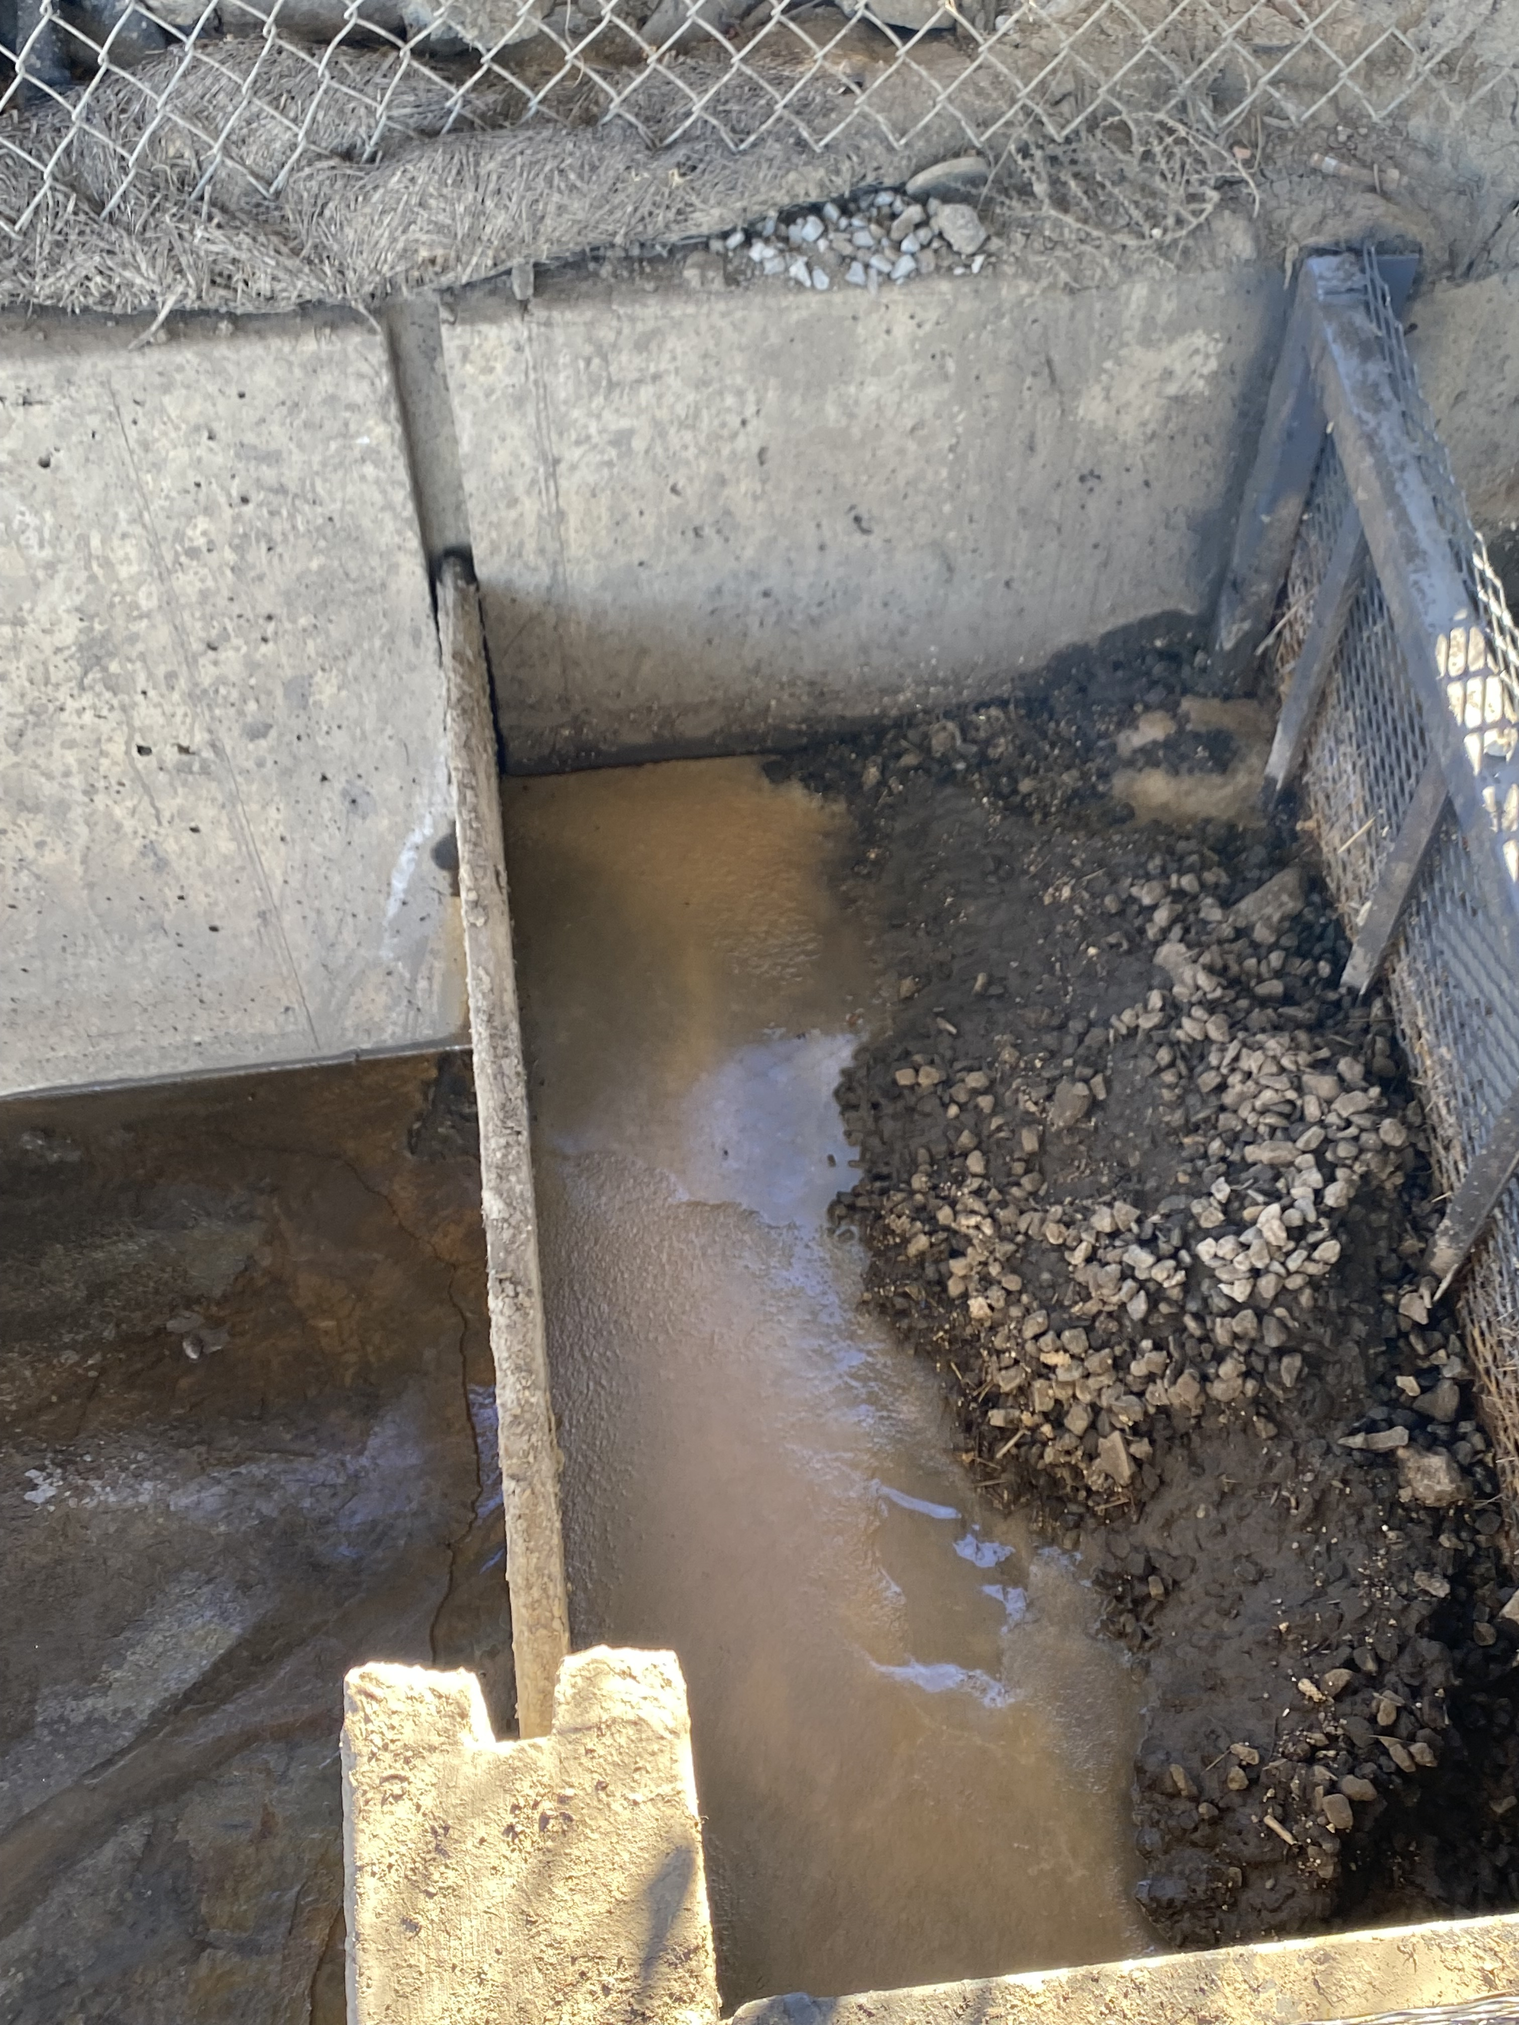
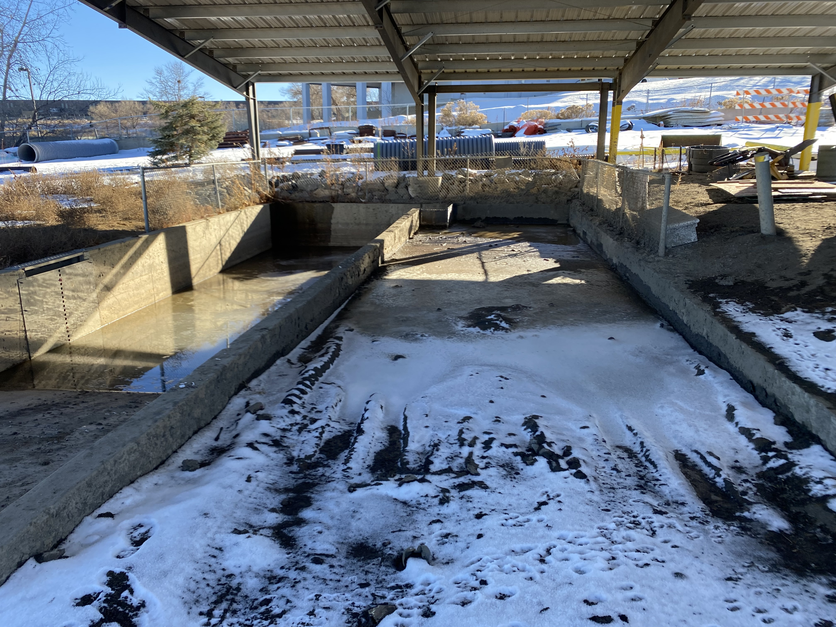
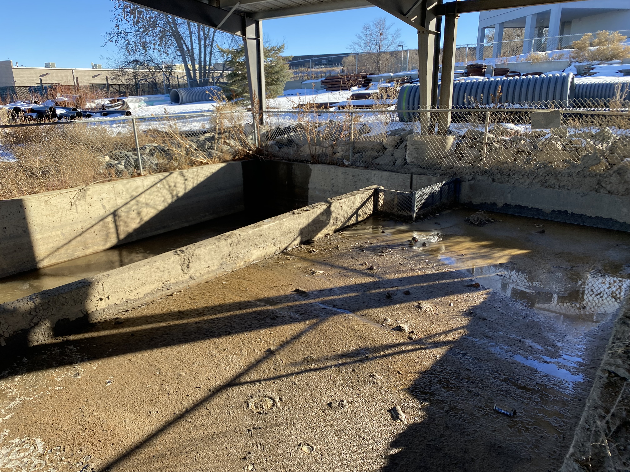

SEMSWA Vac Truck Waste Facility
  The facility’s washout bay has two chambers. SEMSWA’s vac truck waste is dumped into a primary chamber that is designed to hold solid waste, and allows liquid waste to filter into a secondary chamber within the washout bay.

Slide 11
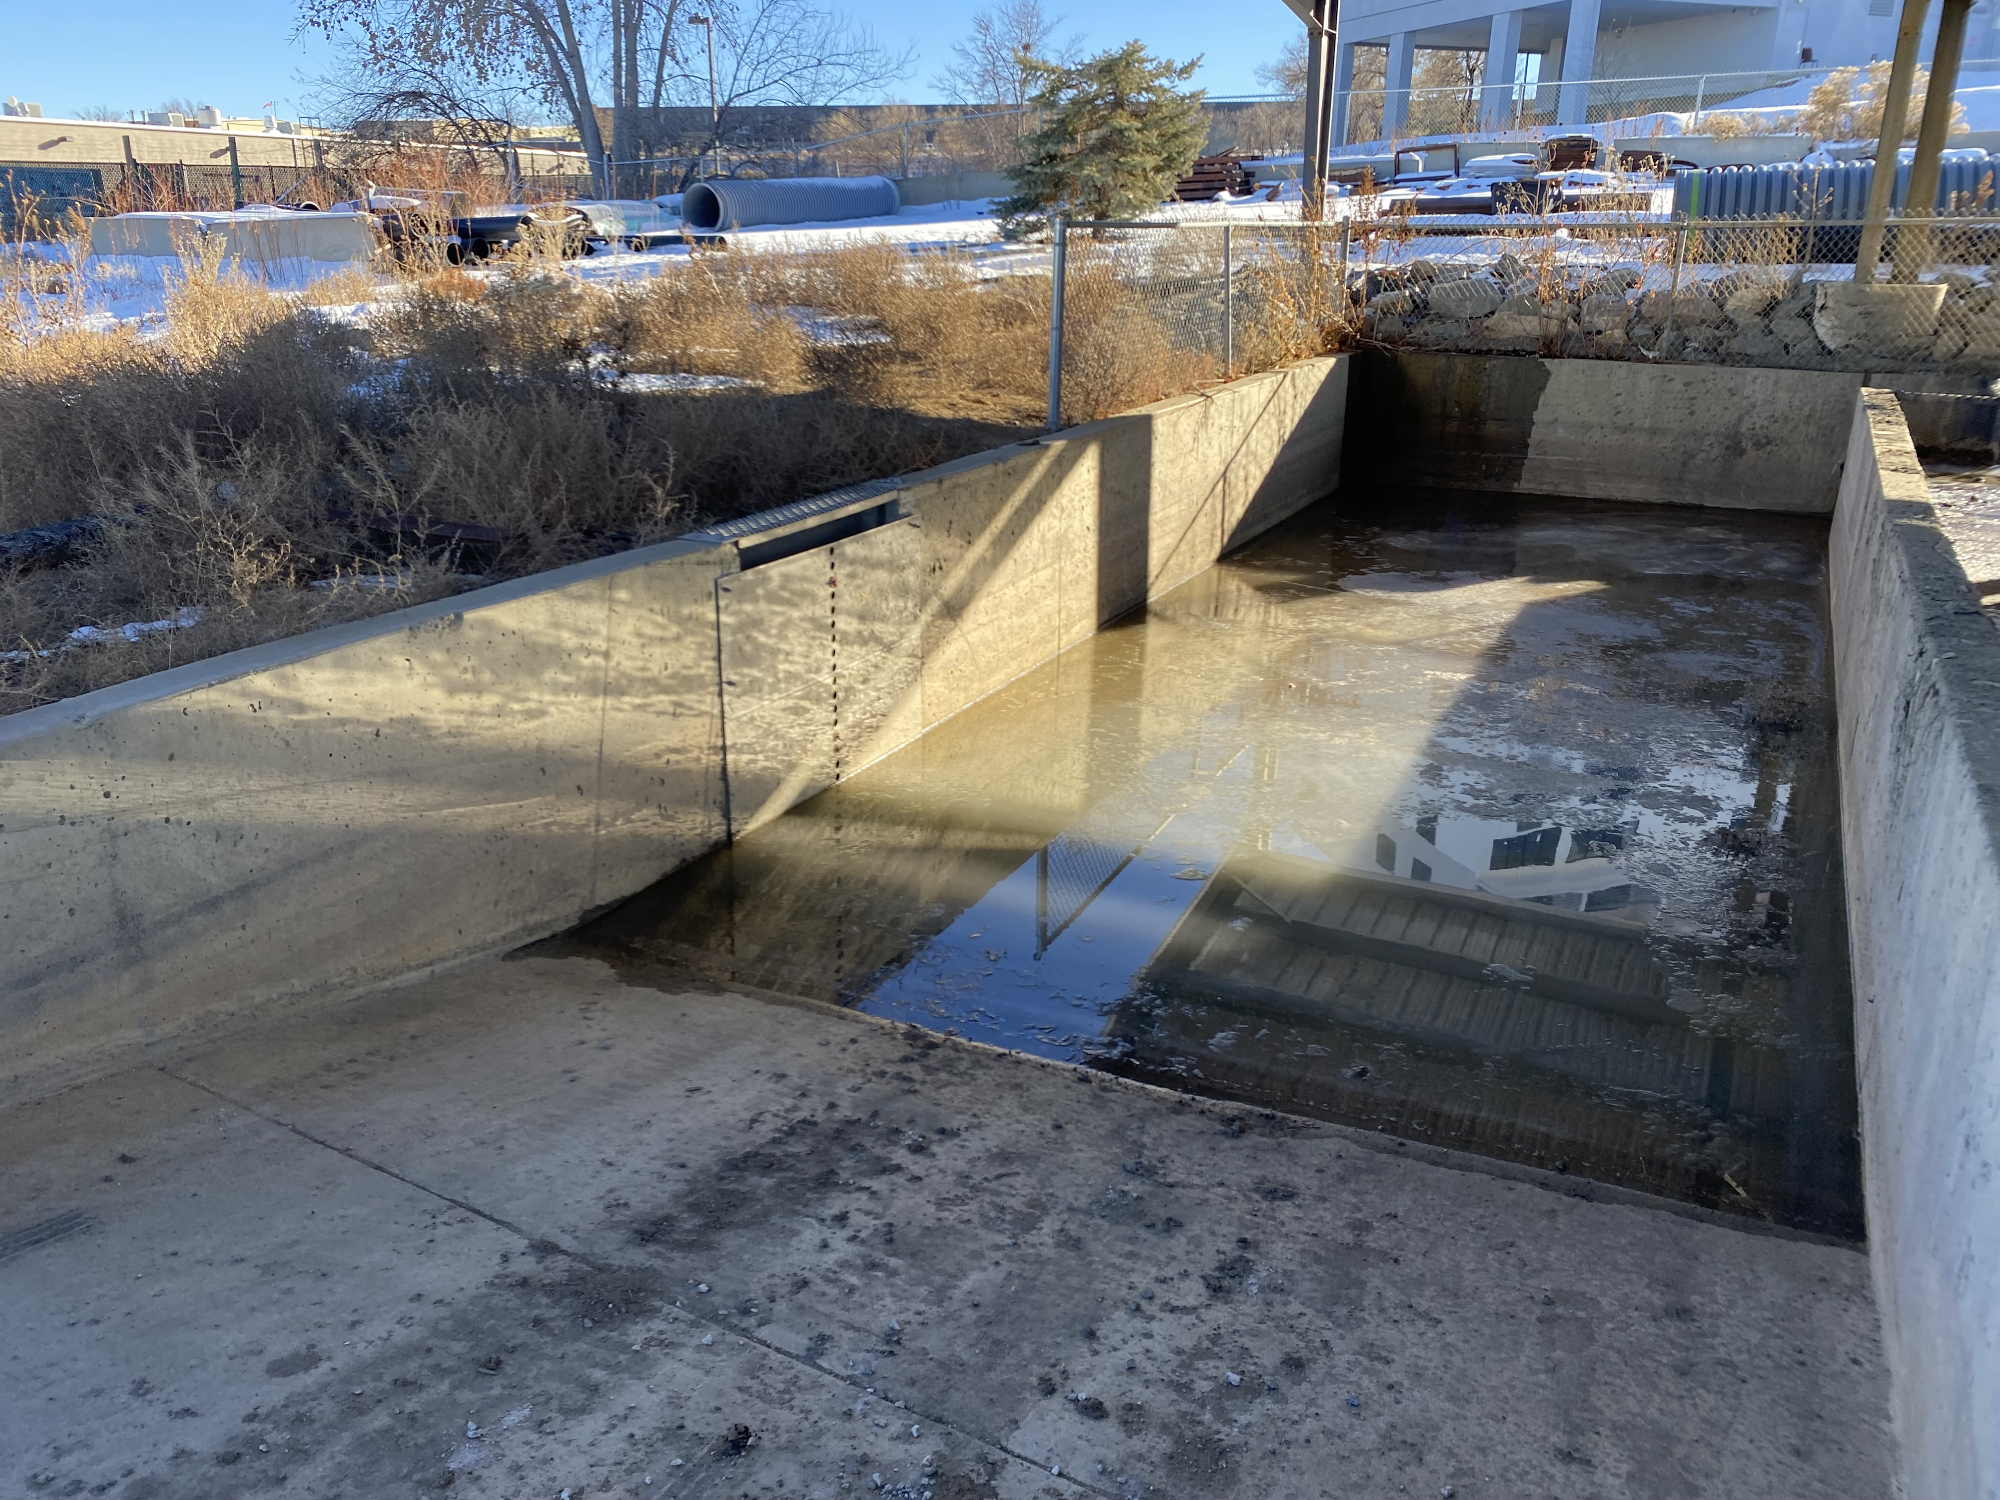
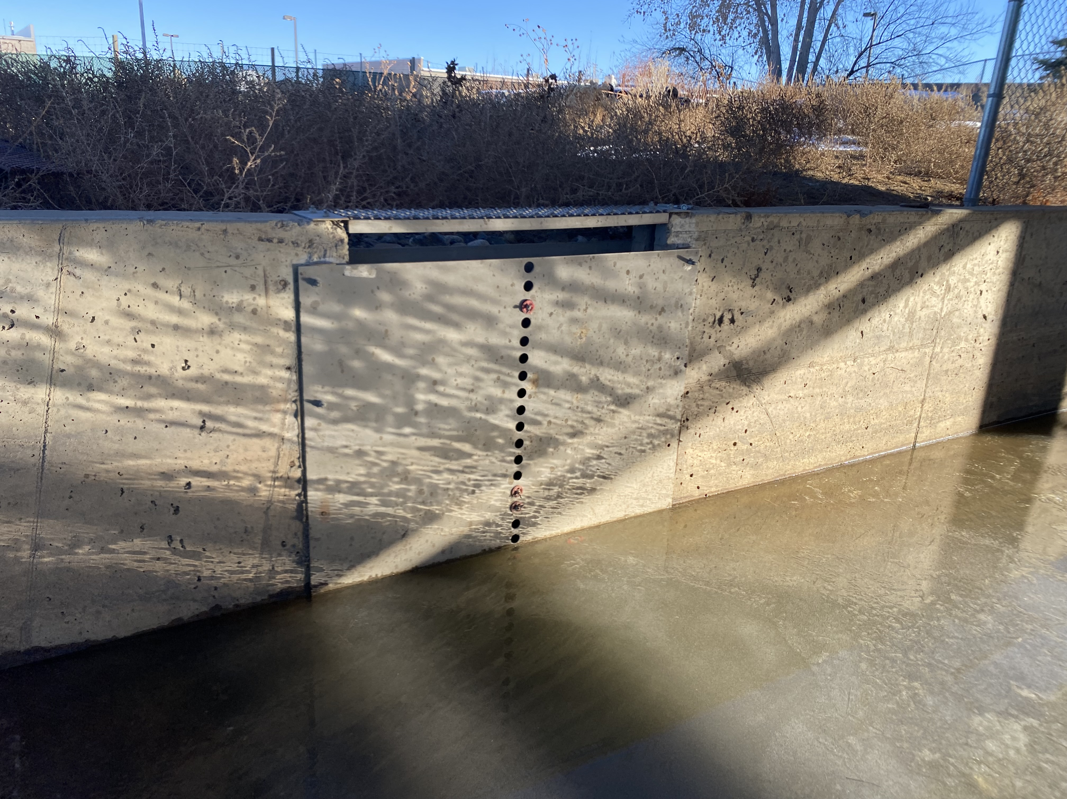
SEMSWA Vac Truck Waste Facility
Liquid waste from the second chamber of the washout bay then passes through a weir plate to a 4” PVC connection that feeds into a below ground sand-oil separator

Slide 12
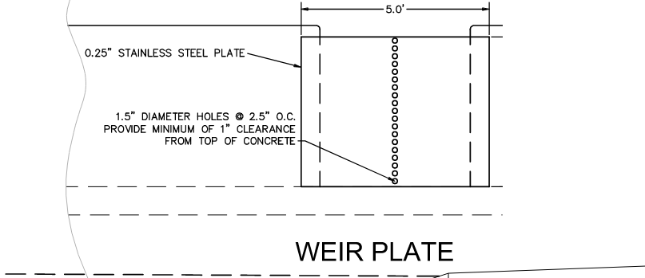
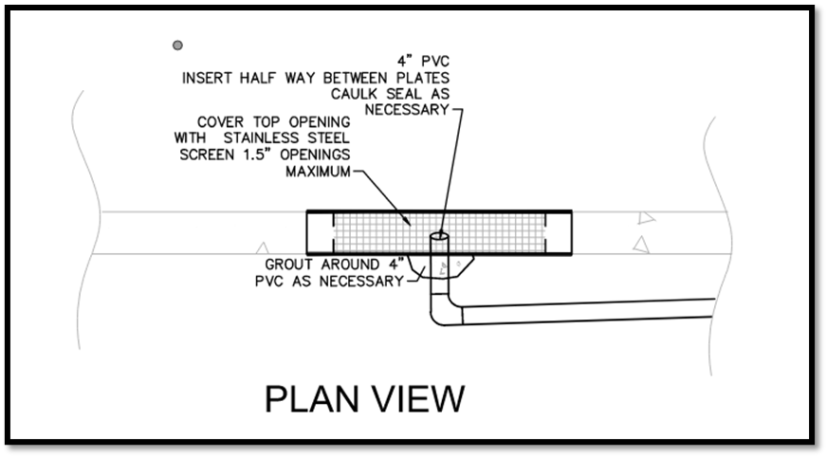
SEMSWA Vac Truck Waste Facility
Liquid waste from the second chamber of the washout bay through a weir plate to a 4” PVC and steel screen to further filter solids.

Slide 13
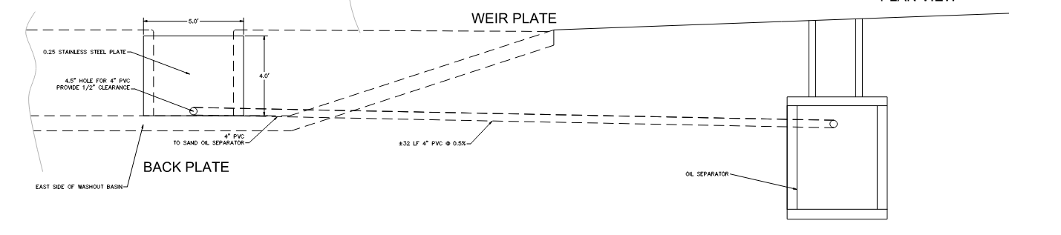
SEMSWA Vac Truck Waste Facility
Liquid waste that discharges from the washout bay flows through the 4” PVC behind the weir plate and into a sand/oil interceptor.

Slide 14
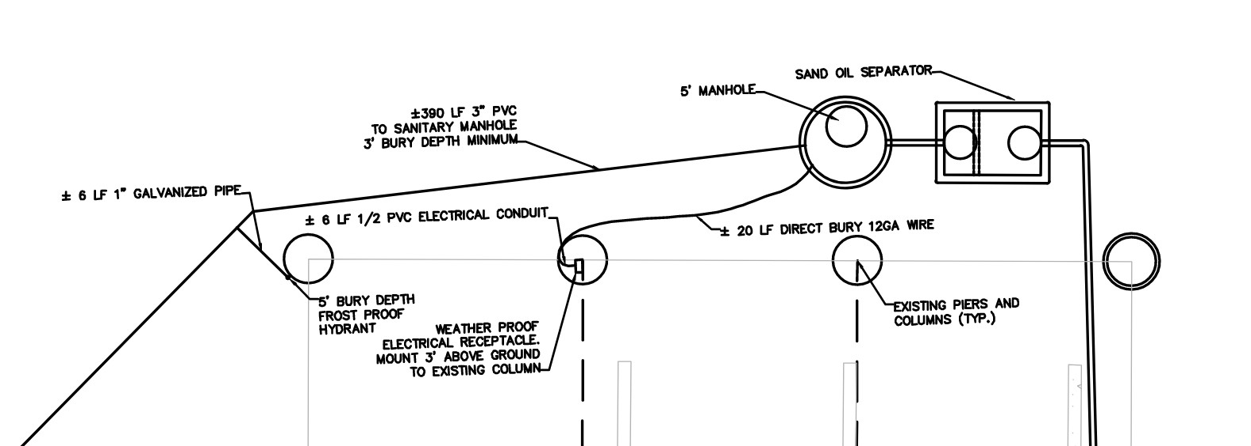
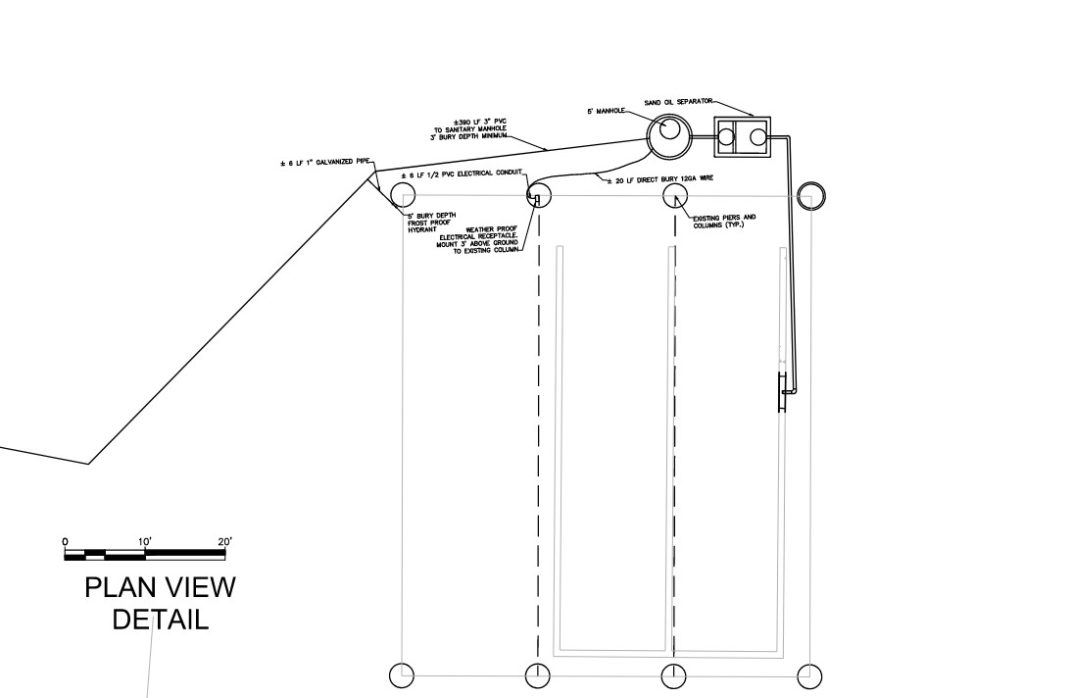
SEMSWA Vac Truck Waste Facility
A sand/oil interceptor is located below grade on the north side of the washout bay

Slide 15
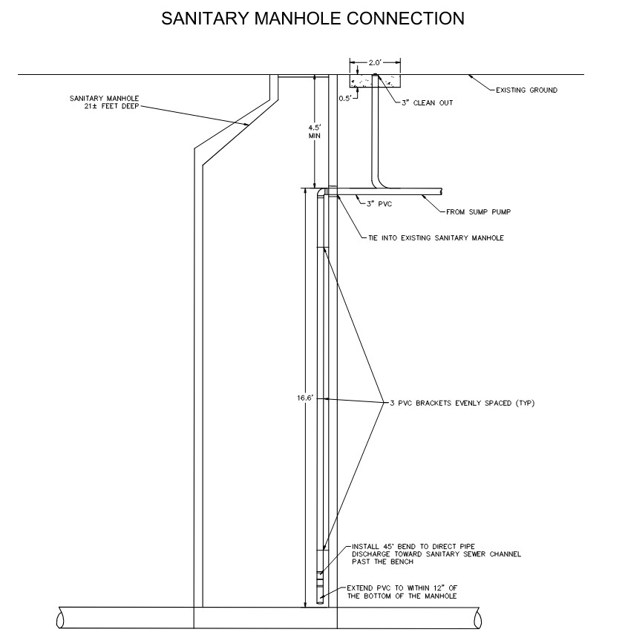
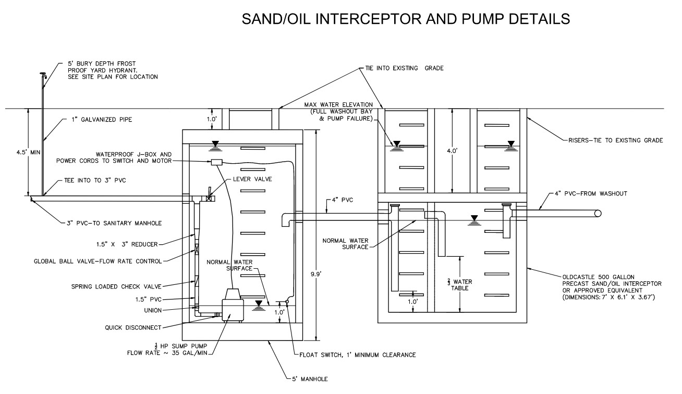
SEMSWA Vac Truck Waste Facility
A sump pump is utilized to extract water from the sand/oil separator into a 3” PVC pipe that ties into an existing sanitary manhole

Slide 16
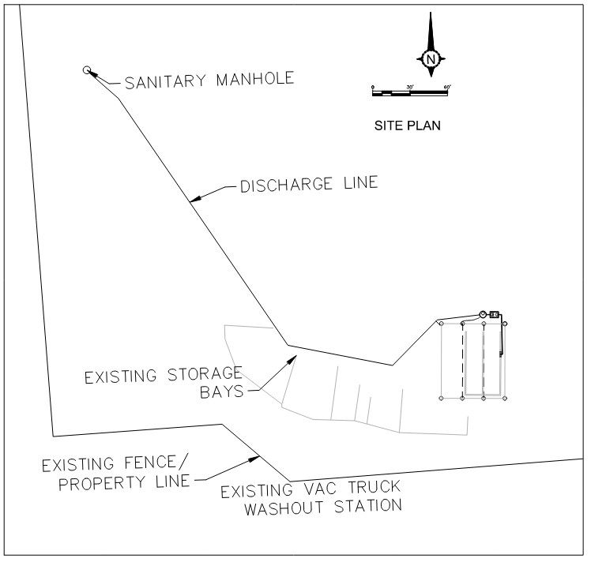
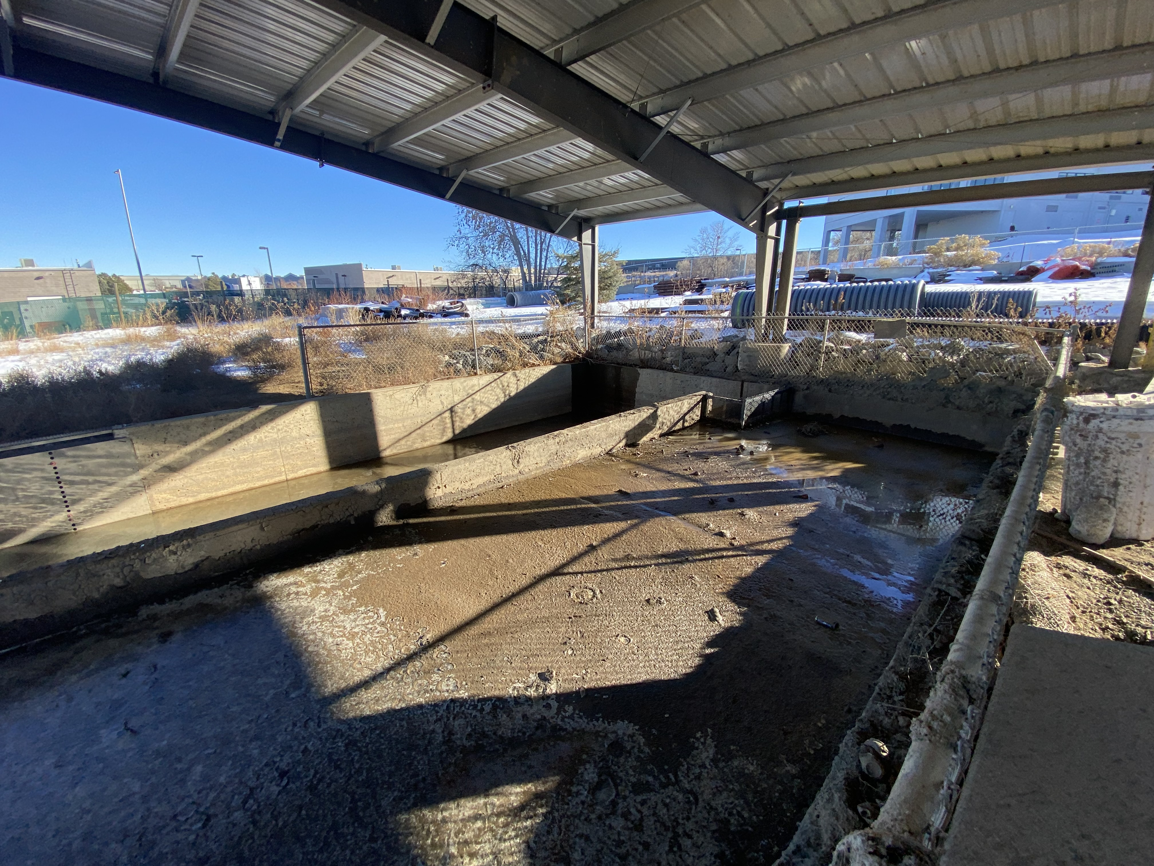
SEMSWA Vac Truck Waste Facility
  Liquid waste is discharged into ACWWA’s sanitary sewer
Solid waste is kept until dried, and then disposed of in a landfill

Slide 17
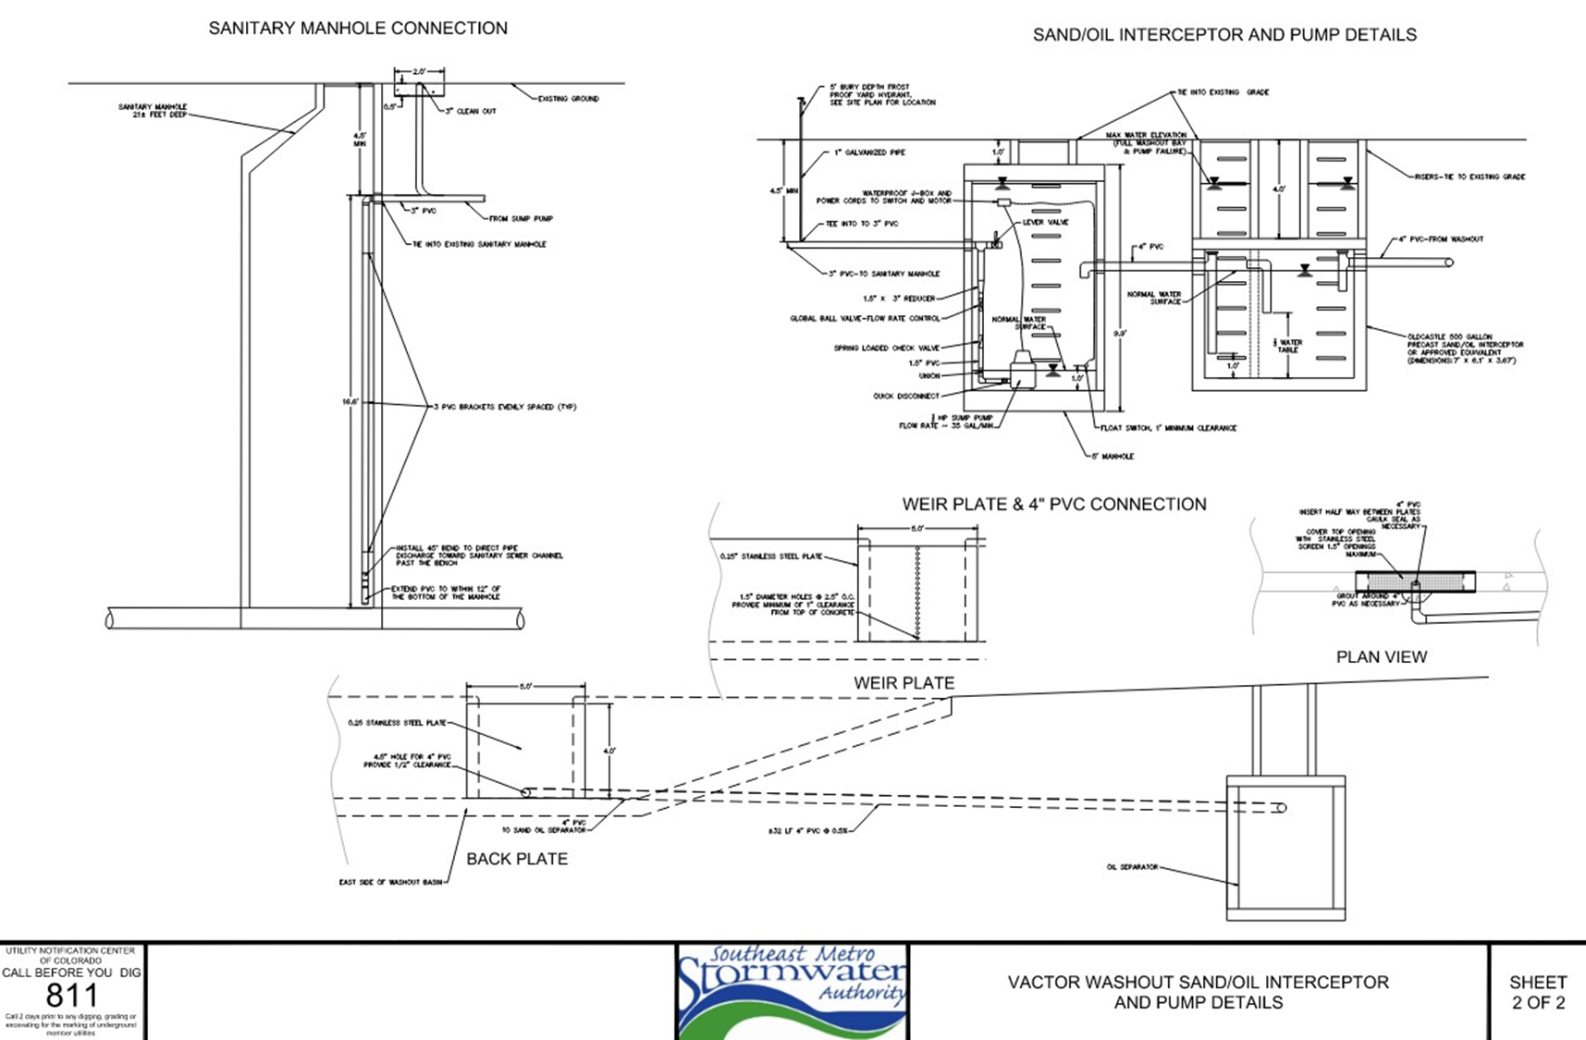

Slide 18
SEMSWA Vac Truck Waste Facility:
Maintenance
Washout bays are typically cleaned out 1-2 times per year, as needed, and prior to municipal inspections. This may vary depending on workload.
Washout bays are cleaned out prior to becoming full to maintain storage capacity.
Sand-oil separator is also cleaned out approx.1-2 times per year, usually at the same time as washout bays
During maintenance visits, crews also operate a generator to power the sump pump that directs liquid waste to the sanitary manhole

Slide 19
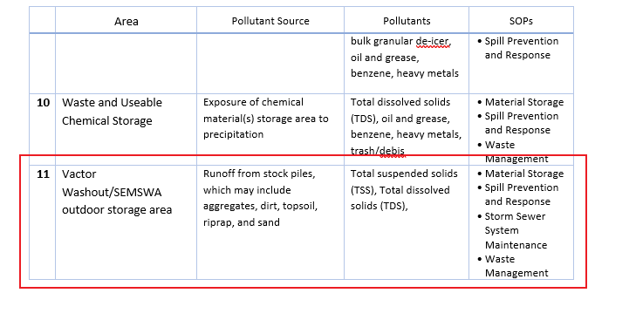
Runoff Control Plan
The SEMSWA Vac Truck Facility is identified as its own “facility operation area” in the Peoria Service Center Runoff Control Plan, with the potential to contribute pollutants if control measures are not used.
“A designated vactor truck waste disposal area located west of Stormwater Outfall #3 contains vactor truck wastes from stormwater maintenance activities. This area is below grade, covered and concrete-lined to allow the vactor truck waste to be contained temporarily before being disposed of at the landfill. Liquid waste is disposed of in the sanitary sewer. Solid wastes are dried and disposed of in a landfill.”

Slide 20
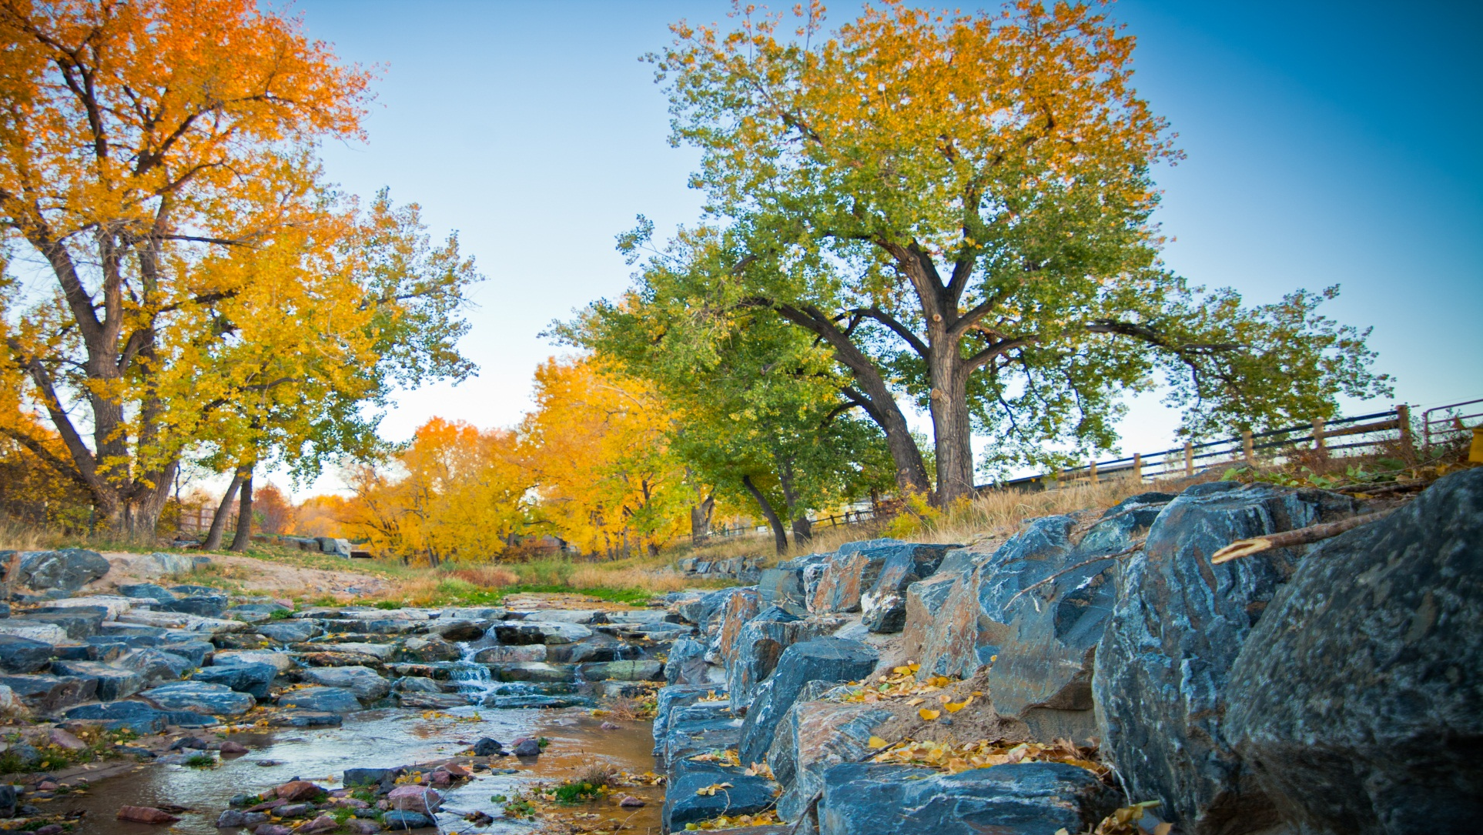
Questions?

